Slide 1
RSE at St. Edmunds.
Notes:
TOS

Slide 2
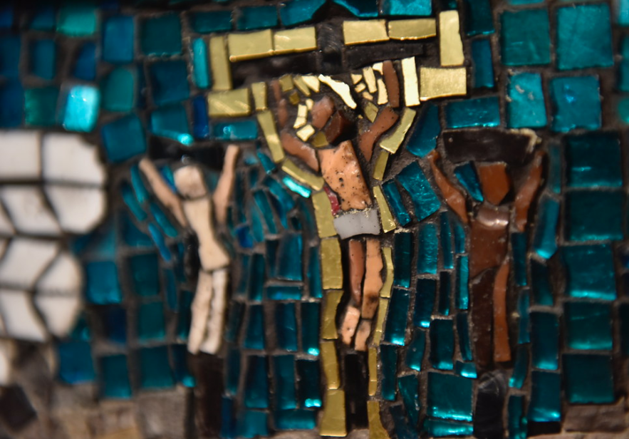
Prayer
Father,
Thank you for your great love for us. You sent your only Son to live with us and show us how to love.
As we explore teaching about relationships to the young people in our school, help us to keep them and Christ at the centre of our minds.
May The Holy Spirit bring us wisdom and peace in guiding our conversations.
We commend to you our words and actions.
Amen

Slide 3
Objectives:
To explore why RSE is important.
To share the statutory requirement of RSE coming into place in September 2020.
To explain what the statutory changes are to RSE provision.
To share the Curriculum and supporting documents from the Catholic Education Service.
To explain the timeline of implementation in our school.

Slide 4

Welcome
What do you want for your children?
What do your children need?
What do your children need?

Slide 5
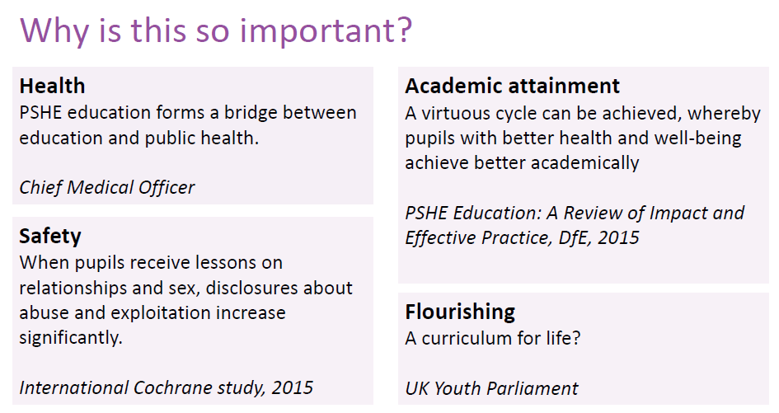

Slide 6
Why is RSE important?
Majority of parents support RSE.
In the past, some parents have said that RSE was the responsibility of parents, and that they welcome the right they have (enshrined in current law) to withdraw their child from Sex education lessons.
However, most of the young people asked disagreed strongly, stressing that their parents have not in fact taught them!
Many parents/carers don’t discuss RSE as much as they wish to!
What do you want for your children?
What do your children need?
Notes:
Sex education forum survey 2011
Baroness Sheila Hollins Today’s teenagers, tomorrow’s parents: Connecting with young people in a complicated world – report to bishops is 2012
Research on young people in the church – one area explored was RSE.

Slide 7

Relationships and Health Education
Relationships and Health Education aims to give young people the information they need to help them develop healthy, nurturing relationships of all kinds.
Our school will cover content on what healthy and unhealthy relationships look like and what makes a good friend, colleague and successful marriage or committed relationship. At the appropriate time, the focus will move to equip your child with knowledge they need to make safe, informed and healthy choices as they progress through adult life.
You can find further details by searching ‘relationships, sex and health education’ on GOV.UK

Slide 8

Why is RSE important?
Research shows that effective, honest, well-delivered sex and relationship education:
  Delays a young person’s first experience of sex
  Means they have fewer sexual partners
  Reduces the chance of teenage pregnancy.
  Abstinence only sex education programmes are not proved effective in these areas.
  (Unesco – international technical guidance on sexuality education)
What do you want for your children?
Notes:
TH
Myth buster – RSE does not encourage Sexual activity
Baroness Sheila Hollins Today’s teenagers, tomorrow’s parents: Connecting with young people in a complicated world – report to bishops is 2012
Unesco - Why comprehensive sexuality education is important

Slide 9

Growing up in 21st century Britain
RSE(PSHE) lessons in schools including lessons that focus on relationships and sex education are taught very differently to the lessons you may have had (or not had) in school.
We are also living in a different society and preparing children to be active citizens in a very different world.

Slide 10
The world in which they live
Celebrity culture
Media influences, social media
Sexualised images –TV, advertising, online
Access to pornography
Online safety & behaviour, sexting, vulnerability to grooming
Impact of all of the above on children and young people’s attitudes, behaviour and values
What do you want for your children?
What do your children need?
Notes:
THAs well s the wonderful aspects of our world and the internet……

Slide 11
What we can offer through RSE:
Understanding their value and the value of others.
Instilling confidence and self-esteem.
Reliable, correct information in a safe learning environment
Knowing how to keep safe.
Helping with peer pressure.
Learning how to make sensible and informed decisions in a changing cultural climate.
Understanding the positive impact of loving God, self, neighbour and our common home.
What do you want for your children?
What do your children need?

Slide 12
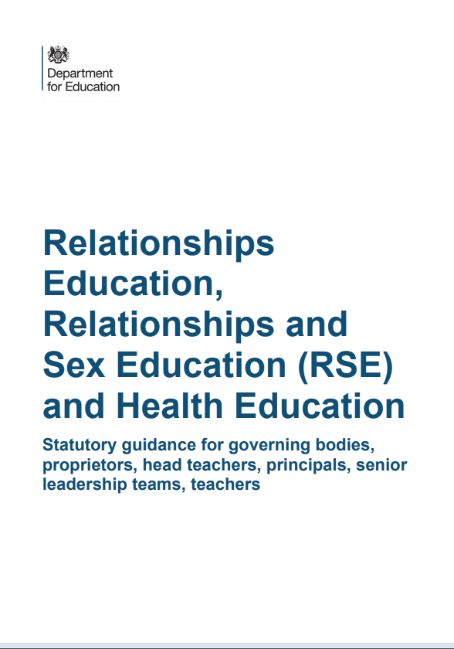
Statutory RSE

Slide 13
Primary Relationships Education
Relationships Education will put in place the building blocks needed for positive and safe relationships, including with family, friends and online.
Your child will be taught what a relationship is, what friendship is, what family means and who can support them.
In an age-appropriate way, your child’s school will cover how to treat each other with kindness, consideration and respect.
By the end of primary school, pupils will have been taught content on:
• families and people who care for me
• caring friendships
• respectful relationships
• online relationships
• being safe
You can find further details by
searching ‘relationships, sex and health education’ on GOV.UK.
Notes:
tos

Slide 14
Primary Health Education
Health Education aims to give your child the information they need to make good decisions about their own health and wellbeing, to
recognise issues in themselves and others, and to seek support as early as possible when issues arise.
By the end of primary school, pupils will have been taught content on:
• mental wellbeing
• internet safety and harms
• physical health and fitness
• healthy eating
• facts and risks associated with drugs, alcohol and tobacco
• health and prevention
• basic first aid
• changing adolescent body
(The science curriculum in all primary schools also includes content on human development, including reproduction, which there is no right to withdraw from.)
You can find further details by
searching ‘relationships, sex and health education’ on GOV.UK.

Slide 15
Statutory Science Curriculum – links with RSE and Health
Key Stage 1 (age 5-7 years) - Statutory Science Curriculum
• Identify, name, draw and label the basic parts of the human body and say which part of the body is associated with each sense
• Notice that animals, including humans, have offspring which grow into adults
• Describe the importance for humans of exercise, eating the right amounts of different types of food, and hygiene

Slide 16
Key Stage 2 (age 7-11 years) - Statutory Science Curriculum
Describe the life process of reproduction in some plants and animals
• Describe the changes as humans develop to old age
• Recognise that living things produce offspring of the same kind, but normally offspring vary and are not identical to their parents

Slide 17
Vision for Relationship and Sex Education in Westminster Catholic Schools
It is our vision for Relationship and Sex Education in Catholic Schools in the Diocese of Westminster that pupils would learn how to foster healthy relationships and friendships in light of the wisdom of the Church.
Pupils will flourish when they truly understand their innate human dignity, love and appreciation of themselves, including respect for their bodies, and the way they were made by God.
Pupils will learn to make sensible and informed decisions in a changing cultural climate, focussing on the virtues, such as patience and chastity, that ultimately lead to true happiness.
Sacred Scripture is key to this vision and the message Jesus gave us to love God, self, neighbour and our common home.
RSE in our schools must always remain faithful to the teaching of the Church, recognising the diversity of pupils’ situations. We aim to be sensitive to each individual, ensuring that their physical and emotional well-being and their safety are of paramount importance.

Slide 18
Catholic Education Service- RSE documents
Model Curricula
Who is responsible for delivering RSE?
Copies on school webpage
“RSE is part of the mission of Catholic schools to educate the whole person. It should be carried out as part of the holistic education which seeks to form as well as inform young people in preparation for adult life.” (CES)

Slide 19
Pedagogical principles
‘it must, above else, qualify as good education’.
Model Curriculum page 1

Slide 20
Differentiated
Cross curricular
Integrated
Coordinated
Balanced
Progressive and developmental
Notes:
th

Slide 21
Pedagogical principles
Progressive and developmental
‘….Led to a deeper and fuller understanding by degrees at a rate which corresponds to their maturing’
Notes:
Must qualify as good education
Like any good curriculum – planned and developmental. Appropriate to age and develops a deeper understanding as pupils mature.
Differentiated and ADAPTED. TRAINING UNDERTAKEN IF PARTICULAR NEED. SEN not withdrawn because of lack of resources or training.
Cross-teach the content where it is most appropriate.
PSHE, RE, SCIENCE ICT- EACH

Slide 22
Pedagogical principles
Differentiated
RSE is sensitive to the different needs of individuals and taught in a way that allows access to pupils at different stages of cognitive and emotional development’
Notes:
th

Slide 23
Pedagogical principles
Cross curricular
‘Each discipline should speak with consistency about the meaning of human love and the virtues that are enshrined in the Church’s teaching on human love.’
Notes:
th

Slide 24
Pedagogical principles
Integrated
‘This can only be achieved if the home, parish and school work to integrate the teaching of RSE’
Notes:
th

Slide 25
Pedagogical principles
Coordinated
None of these educational goals are possible if RSE is not given the time and importance it deserves by those who plan and implement its delivery in school. RSE must be taken seriously by school leaders; led properly by someone who has the time and expertise to co-ordinate the subject with dedication and commitment at a senior level; taught by those committed to doing it well; taught as part of a whole-school approach by those who are able to celebrate – not merely tolerate – the teaching of the Church on love and human sexuality.

Slide 26
Pedagogical principles
Balanced
Whilst promoting Catholic virtues, schools should ensure that children and young people are offered a broad and balanced RSE programme which provides them with clear factual, scientific information when relevant and meets the statutory requirements placed on schools.

Slide 27
Changes- Primary
Primary schools | What’s new? | What’s not?
Sex Education |  | Some schools teach beyond statutory requirements. Parents can withdraw from sex education taught outside of science, beyond statutory obligations. Science national curriculum includes content on human development, including reproduction.
Relationship Education | Now a statutory obligation: • families and people who care for me • caring friendships • respectful relationships • online relationships • being safe | Some of this has already been addressed through RE and PSHE and computing and in other ways e.g. SEAL Keeping children safe in education has had an impact in this area.
Health Education | Now a statutory obligation • mental wellbeing • internet safety and harms • physical health and fitness • healthy eating • facts and risks associated with drugs, alcohol and tobacco • health and prevention • basic first aid • changing adolescent body | Science and PSHE both cover a lot of this content already e.g. Computing - cyber bullying Science – Hygiene, nutrition, exercise, alcohol.

Slide 28
Model Curricular
A model RSE Curriculum for Primary
A model RSE Curriculum for Secondary
3 themes
Created and loved by God
Created to love others
Created to live in community
Model Curriculum page 2

Slide 29
Created and loved by God
The Christian imperative to love self, made in the image and likeness of God, shows an understanding of the importance of valuing and understanding oneself as the basis for personal relationships.
Education in virtue
Religious understanding of the human person: loving myself.
Me, my body and my health
Emotional wellbeing and attitudes
Life cycles and fertility

Slide 30
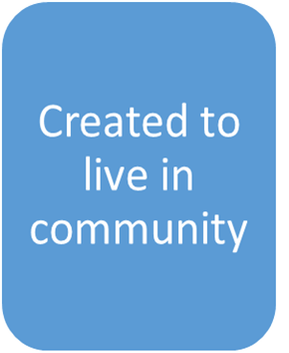
  Human beings are relational by nature and live in the wider community. Through our exchange with others, our mutual service and through dialogue, we attempt to proclaim and extend the Kingdom of God for the good of individuals and the good of society.
Education in virtue
Religious understanding of the importance human communities
Living in the wider world

Slide 31
Education in Virtue
Each theme begins with a statement of the virtues which are necessary to living well in relationship with others and these virtues should underpin the teach habits which are learned from experiencing but also should emerge as a consequence of it. Virtues are, and are gained through imitation the same virtues being modelled by those who teach. They express the qualities of character that schools should seek to develop in their pupils, through their exemplification by the whole community of which the pupils are a part. These virtues reflect our Christian tradition but they are also, of course, fundamental human virtues which are universally shared
Model Curriculum page 2
Notes:
th

Slide 32
The Outcome:
what can you expect from students and staff?
Discerning and mindful human beings willing to participate as positive citizens
Solution-focused individuals – knowing how and when to solve their own problems, and when to seek help
Resilient, caring people – caring for self and others
Questioning and challenging minds that want to learn
Self-knowledge for self-efficacy
Emotionally literate individuals
Exploration skills – looking for their own answers
Through this program, we can be confident that a focus on well-being and mental health not only enables us to provide a healthy and happy school environment for students and staff, and prepare the citizens of tomorrow with sound character and values, but also directly supports their more immediate mission: the promotion of effective learning.

Slide 33
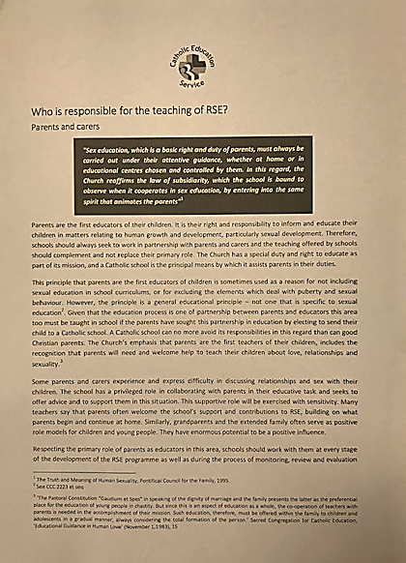
Who is responsible for teaching RSE?
Parents
Governors
Headteacher
Teachers and other staff
Visitors and external speakers
Parish and diocese
https://www.catholiceducation.org.uk/schools/relationship-sex-education
Notes:
‘school-based programmes are complemented with the involvement of parents and teachers, training institutes and youth-friendly services.’

Slide 34
Partnership with parents
Primary educators of children
Unique knowledge of your children
Ability to have regular conversations
Impart our shared values.
Teach along side the school.
RSE most effective when reinforced at home and elsewhere.
Some parents find it difficult or lack confidence.
Some homes are unable to provide this.
Some children prefer these conversations outside the home
Notes:
school-based programmes are complemented with the involvement of parents and teachers, training institutes and youth-friendly services. UNESCO

Slide 35
DfE- Parents rights
The important lessons you teach your child about healthy relationships, looking after themselves and staying safe, are respected and valued under this new curriculum.
Teaching at school will complement and reinforce the lessons you teach your child as they grow up.
Your child’s school is required to consult with you when developing and renewing their policies on Relationships Education. These policies must be published online and be available to anybody free of charge.
You can express your opinion, and this will help your child’s school decide how and when to cover the content of the statutory guidance. It may also help them decide whether to teach additional non-statutory content.
Schools are required to ensure their teaching reflects the age and religious background of their pupils.
Notes:
Th
Link between parents as first teachers and parent rights.
Reassure they will be informed about what they will be learning.

Slide 36
DfE - Right to withdraw your child- Primary
You cannot withdraw your child from Relationships Education because it is important that all children receive this content, covering topics such as friendships and how to stay safe.
Parents of Year 6 pupils have always been welcomed to attend a meeting in the Summer Term, at St. Edmund’s, before they leave the security of Primary School to prepare them for the transition to Secondary. We have always shared the materials that are used with the pupils and asked parents to share their questions or concerns.
ALL PARENTS are always welcome to look at and discuss any aspect of the Curriculum.
As a parent, if you do not want your child to take part in some or all of the lessons you can ask that they are withdrawn.
The science curriculum in all maintained schools includes content on human development, including reproduction, which there is no right to withdraw from.

Slide 37
Benefits of children being part of lessons in school
Learning alongside their classmates creates a supportive atmosphere and a shared understanding that these topics are relevant to all of us.
Can help to encourage empathy and an understanding of the wider school community which supports our anti-bullying policy
• Creates a safe space to learn with ground rules as well as the usual class rules
• Lesson led by the class teacher who knows the children and understands their needs in terms of learning styles, additional support needed and finding out what their current understanding of a topic is
• Children are naturally curious and we feel that it is better to know they are getting accurate, up to date, age appropriate information rather than finding the answer to their questions by searching online, for example

Slide 38
Parent Consultation
The school welcomes and will take account of and listen to your views.
Decisions will also be based on the needs of pupils, the views of staff and governors as well as compliance with legal requirements as set out in the DfE guidance and the Equalities Act 2010.
Ultimate decisions about the curriculum and policy will be up to the school.
Notes:
TOS
Use existing strategies if they are effective - multiple strategies
Group / one to one/ form/ online etc…..
Same questions – multiple formats

Slide 39
An inclusive school environment
This helps to support the following:
An acceptance that different faiths and beliefs should be tolerated and not the cause for prejudicial or discriminatory behaviour and to encourage further tolerance and harmony between different cultural traditions
• The school has duties under the Equalities Act, British Values, and the proposed new Ofsted framework
• Children are growing up in a diverse world and will need to be able to work, live, play with people from all backgrounds

Slide 40

The Equality Act 2010 places duties on schools not just to address prejudice-based bullying but also to help to prevent it happening, and in doing so to keep protected characteristic groups safe.
PSHE and RSE education, with its focus on identity and equality, can help schools to fulfil this duty.

Slide 41
Timeline - What Next?
Parent Information Session 1 – Today
Statutory requirements
Distinctive Catholic approach
Parent consultation on policy from 8th May – 22nd June
You are welcome to contribute to this consultation by/ via email or letter.
Parents will be informed of the conclusions that have been reached and the curriculum and policy that has been adopted via the school website.
Parent information session 2 date- TBC
Curriculum and resources
Notes:
TOS

Slide 42
Closing Prayer
Heavenly Father,
As we come to the end of our time together we thank you for what has been accomplished here.
May the matters discussed serve as a catalyst to move us forward and cause us to advance and see growth in all areas of our lives.
May we leave here recognising that you are the God of all wisdom and you are willing to lead us forward.
This we pray in the name of Jesus the Lord,
Amen
Notes:
TOS

